Slide 1
Mobile Forensics
Lecture 5
SQLite

Slide 2
Introduction
A large amount of data is being stored and processed in relational databases.
The most widely used database system in the world is undoubtedly SQLite since it is the default solution for the Android and iOS operating systems.
In the vast majority of criminal investigations involving information technology, one task is to make information stored in such databases accessible.
SQLite supports most of the SQL language commands.

Slide 3
The SQLite File Structure
SQLite is a single-file database engine
i.e., all tables are managed in only one file on disk.
There is no intermediary server process
an application has to communicate with first, for storing data.
it provides a library and an easy to use programming interface. This fact has significantly contributed to the current spread and popularity of the program

Slide 4
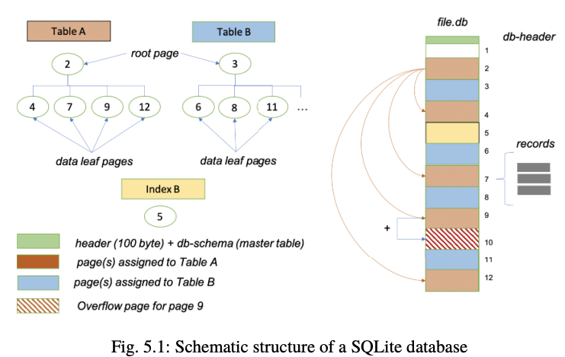

Slide 5
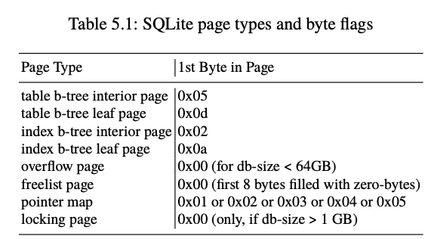

Slide 6
a table is distributed over one or more pages of the database on the binary level (see Fig. 5.1).
Each data page again contains one or more records, for precisely one table.
To access and acquire all records of a particular table, we must first determine which pages of the database are associated with this table.
This information can again be taken from the first page of the database.

Slide 7
A page with links to other pages only is called a b-tree interior page
The record nodes are saved in table b-tree leaf pages
Beyond this, a table can have multiple indexes. An index contains links to normal table records to speed up searching and sorting by specific fields.
Whenever we create an index, SQLite creates a B-tree structure to hold the index data as well.
Similar to normal tables we can distinguish between index b-tree interior pages as well as index b-tree leaf pages.

Slide 8
The Database Header
Every forensic investigation starts with analysing the file header.
The header contains important information that will help us to carve for deleted records.
The fields of the header have a precisely defined size and position (see Fig. 5.2).
The individual (multi-byte) fields are encoded as big endian (BE) values.

Slide 9
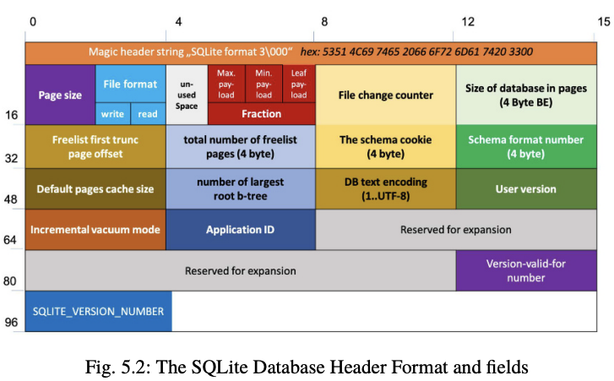

Slide 10
Each database starts with the header string.
a two-byte big-endian integer value representing the database’s page size. The value in this field must be a power of two. The range of values is between 512 and 32768.
The two flag bytes at offset 18 and 19 control the read and write permission for the database. The values should typically always be either a 1 or a 2

Slide 11
The 1-byte integer value at offset 20 of the header is used to apply for certain SQLite extensions. The number of bytes specified here reduces the usable area within the page.
The bytes on offset 21 to 23 have fixed values per definition. Maximum and minimum payload fraction must be 64, 32. The byte for the leaf payload fraction always holds the value 32.
With each transaction carried out on the database, the 4-byte big-endian integer at offset 24 is usually incremented by one.

Slide 12
With the 4-byte integer on offset 28 stores the size of the in-header database in pages
At offset 32, we can find a 4-byte big-endian integer which indicates the beginning of the so-called freelist
At offset 36 represents the total number of entries on the freelist. Together with the start address, one can thus automatically iterate over the released pages.

Slide 13
Each change to the database schema, such as adding or deleting a table or creating an index, automatically leads to an increment of the value at offset 40.
The 4-byte value at offset 44 represents the format number. This field has a value between 1 and 4. For a SQLite database created with the latest version of the database, the value is always 4 and thus supports the more SQL commands.

Slide 14
The value default pages cache size at offset 48 queries or sets the suggested maximum number of pages of disk cache for a database file.
The 4-byte big-endian integer value at offset 52 is only used to manage pointermaps for auto vacuum-databases. A non-zero value means that this database file contains pointer map-pages.
All strings in the database are encoded with the same encoding. There are only 3 valid encodings: UFT8 (value 1), UTF16LE (value 2), UTF16BE (value 3). For the analysis of the database, this field value must always be read first.

Slide 15
The integer at offset 64 is true for incremental_vacuum and false for auto_vacuum mode. A value is larger than 0 means that the database reclaims space after data has been deleted. An autovacuum database thus contains few deleted artefacts - if any. It is defragmented automatically.
The Application ID at offset 68 can be set by the Application programmer. It is not used by SQLite.

Slide 16
Offset 92 covers the value of the change counter. The integer at offset 92 indicates which transaction the version number is valid for.
The 4-byte integer at offset 96 stores the SQLITE_VERSION_NUMBER value. The version number of the database library with which changes were last made to the database is noted here.

Slide 17
Storage Classes, Serial Types and Varint-Encoding
SQLite uses strict typing.
each value stored is mapped to one of the five storage classes (Table 5.2)
The word storage class is just another term for a data type
the latter is more commonly used in connection with programming language
SQLite supports storage classes for integers (INTEGER), floating-point numbers (REAL), strings (TEXT), binary objects (BLOB), and other numeric data such as dates (NUMERIC).

Slide 18
a length occupied by a cell value
An integer, for example, will consume a length between zero and a maximum of 8 Bytes
A floatingpoint number is mapped to a 64-bit field.
A text can have an arbitrary length.
SQLite uses the so-called serial types to map storage class and length

Slide 19
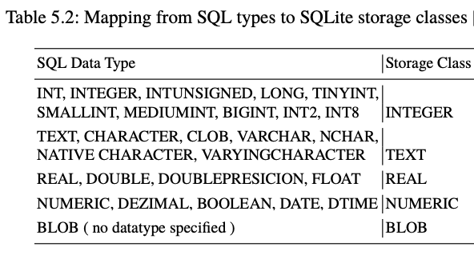

Slide 20
Table 5.3 lists all possible serial types.
For serial types 0, 8, 9, the value is zero bytes in length.
The serial type is used whenever the type and length of a cell must be determined.

Slide 21
SQLite uses a particular encoding for storing serial types.
The representation form used is a variable-length integer (varint).
SQLite version 3 uses this simple byteoriented encoding where each byte contains 7 bits of the integer being encoded

Slide 22
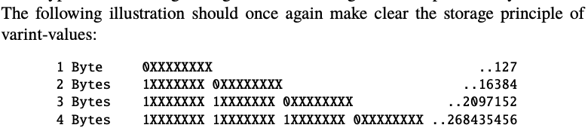

Slide 23
Since texts have a variable size, and the length calculation is performed by a formula
A numerical value above 12 or 13 can only occur with texts or BLOBs
An odd value will be correspondingly for texts

Slide 24
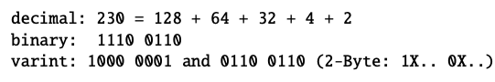
A JPEG file with, let us say, the length of 109 Bytes would be encoded with the serial type number 230 since N∗ 2 + 12 is what we need to calculate for a binary object. However, since we cannot map this value with 7 bits, we have to add a second byte for the varint：

Slide 25
Decoding The SQLite_Master Table
A database schema is a set of data definitions that define the structural design of a database.
The schema table contains all database objects in the database and the statement used to create each object.
With the schema table’s help, all table names, the corresponding column names and data types can be determined.
Each table entry is opened by two additional fields: the rowid and the payload (see Fig. 5.3)

Slide 26
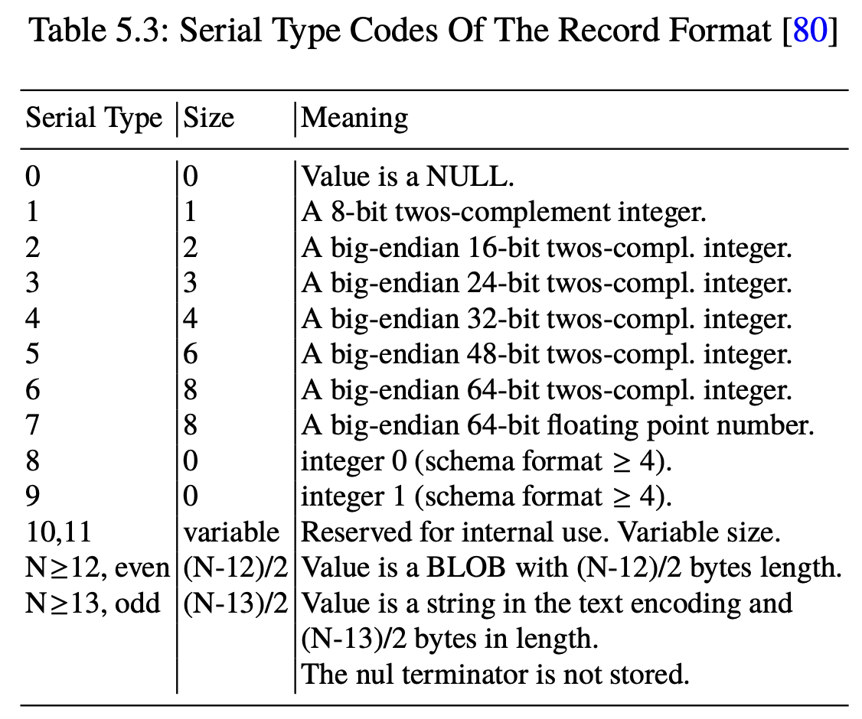

Slide 27
Both values are only visible on the binary level.
Any row of the master table and therefore every database object is assigned to a unique, non-NULL, signed 64-bit integer - the rowid.
This value is used as the access key for the data in the underlying B-tree.
On the binary level, each table row starts with a rowid number greater than null.

Slide 28
Most tables in a typical SQLite database schema are rowid tables.
A rowid table is defined as any table in an SQLite schema that is not a virtual table and is not a WITHOUT ROWID table.
The rowid is not part of the table definition.
A payload field that stores the length of the record follows directly after the rowid

Slide 29
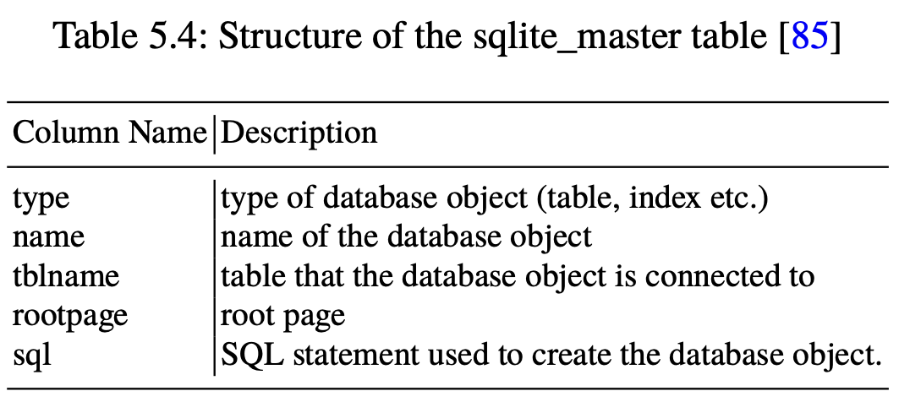

Slide 30
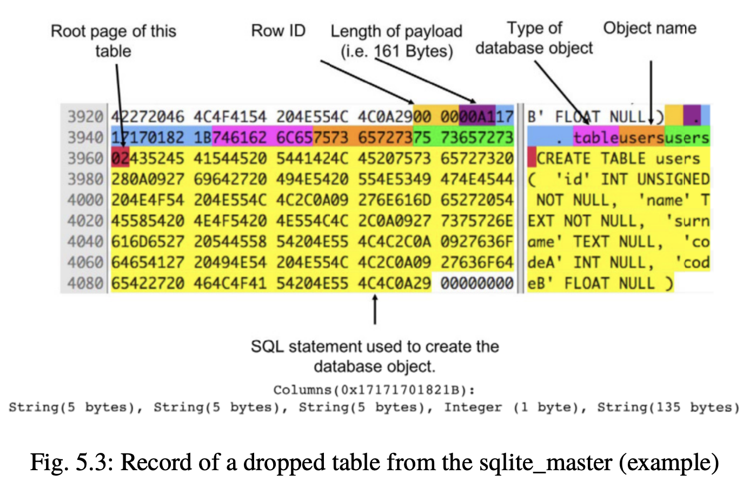

Slide 31
By analyzing the SQL statement, a storage class can be derived for each table column.
For the five columns of the table , the following columns can be identified: INT, TEXT, TEXT, INT, REAL.
This type of vector can be considered as a kind of fingerprint.

Slide 32
Page Structure
To access the data, we must understand the structure of a page.
Each page starts with a header, with a total size of 8 bytes in the case of a data leaf page (see Fig. 5.4).
All header bytes are big-endian values.
The header starts with the page type at offset 0.

Slide 33
In the case of a leaf page, the page starts with the value 0x0D. It can be classified from the other pages by reading this value.
The 2-byte value at offset 1 marks the beginning of the first free block on the page.
A free block is created whenever a record is deleted from the database.

Slide 34
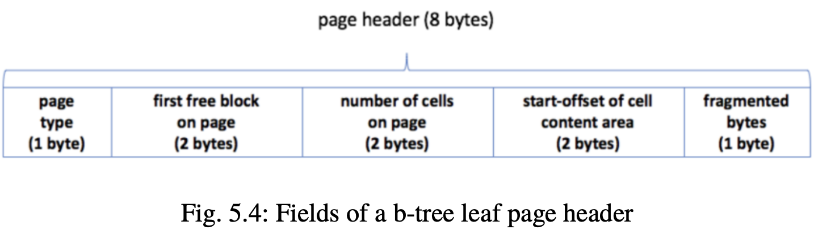

Slide 35
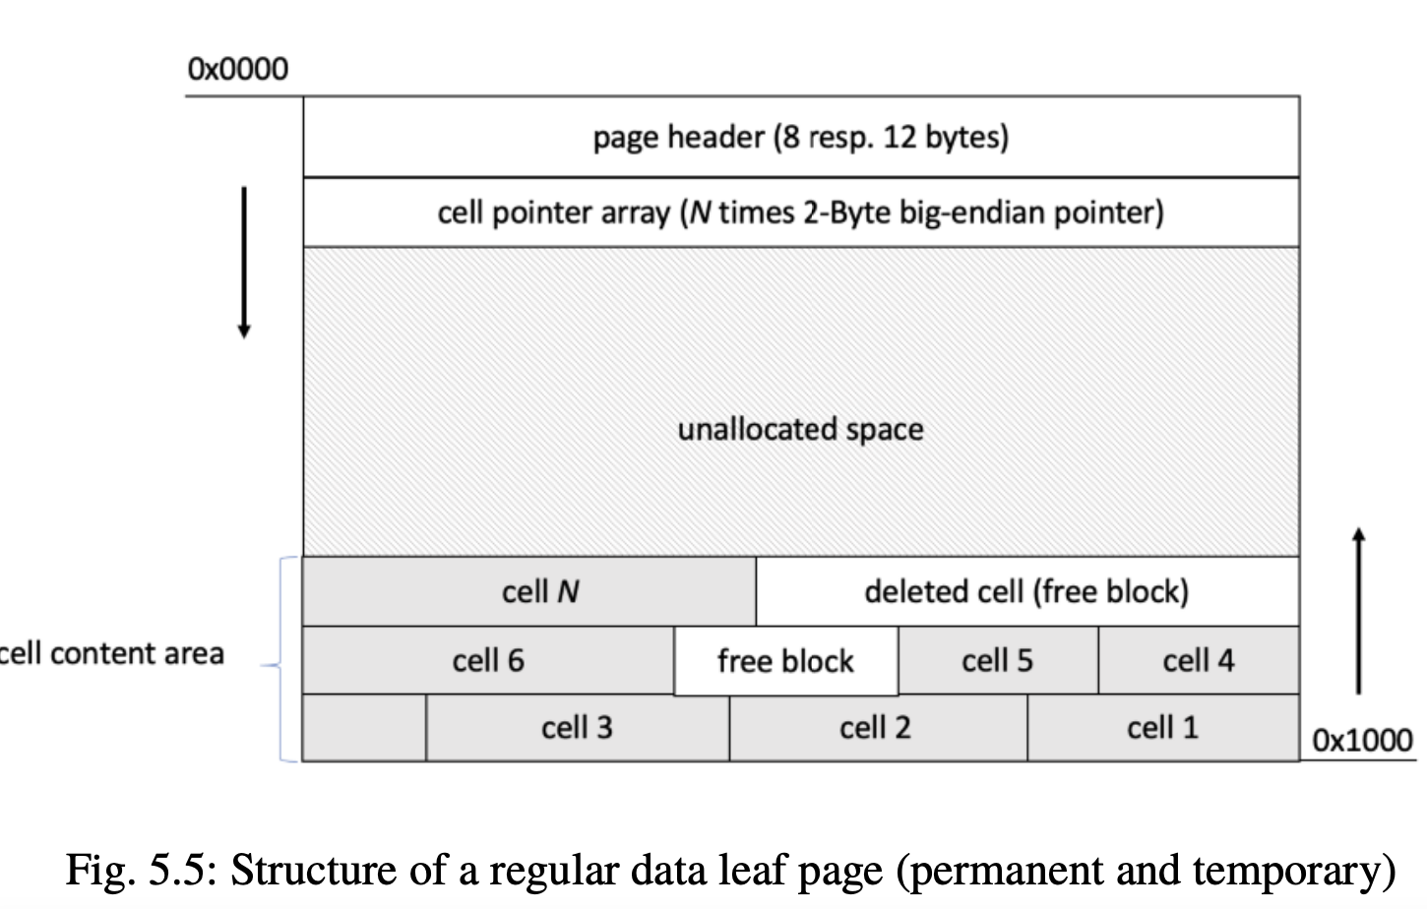

Slide 36
The next header field at offset 5 provides the start-offset of the content area. A b-tree leaf page is divided into regions (see Fig. 5.5)
The cell content area is always located at the bottom of the page.
The header and the cell pointer array are always located at the beginning of the page. Between them resides the unallocated space.

Slide 37
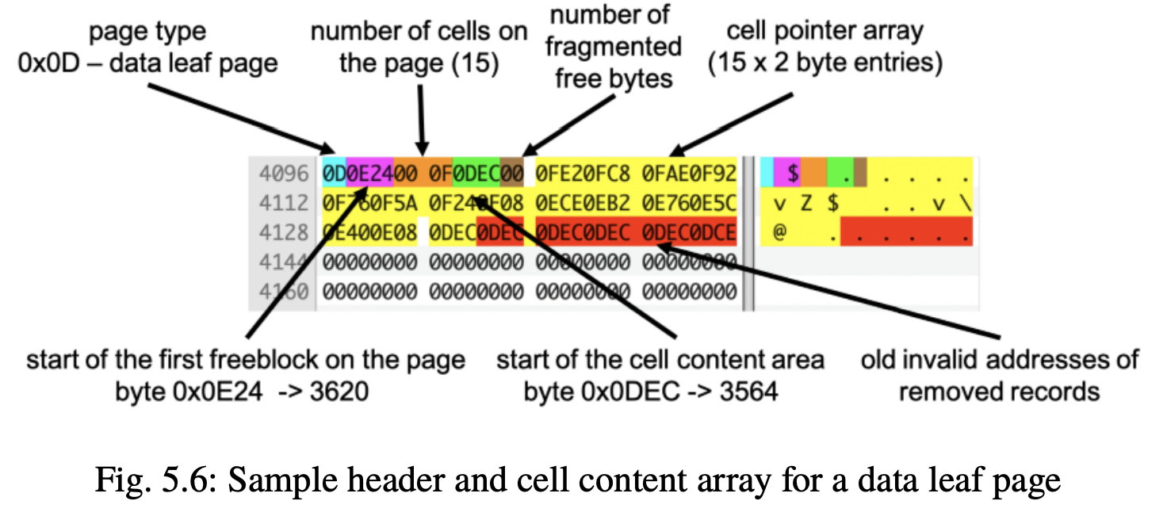

Slide 38
Figure 5.6 shows an example of the header of a page on a binary level.
In addition to 15 cells, we can also find at least one free block of offset 3620(0x0E24).
The content area in this example starts at 0x0DEC. The cell pointer array is highlighted in yellow.

Slide 39
five more cell pointers shown in red.
The value of the surplus cell offsets corresponds to the start offset of the cell content area.
From this, we can conclude that apparently, five other records must have existed on the page in the past.

Slide 40
Slack space is the leftover storage that exists on a page when records do not need all the space which has been allocated.
Slack areas are always created when records are deleted.
Hence, the total amount of slack space can thus be calculated as shown in the equation below.

Slide 41
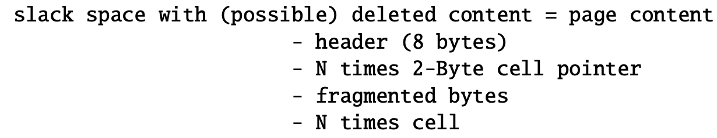

Slide 42
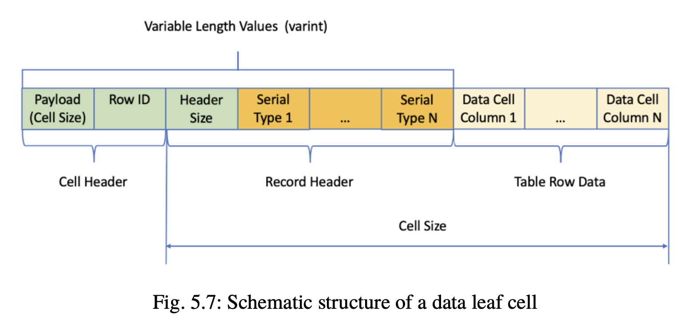
Recovering Data Records

Slide 43
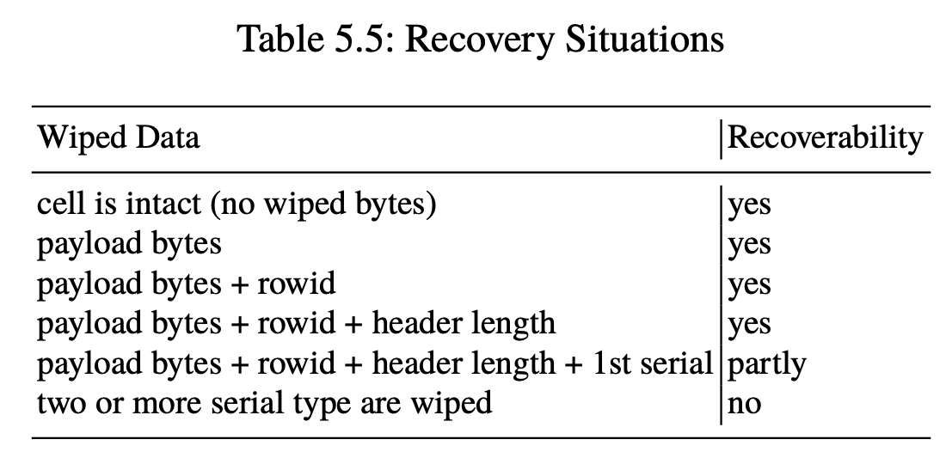

Slide 44
Accessing The Freelist
the link within the table tree is removed
From now, the page cannot be accessed from an active table.
However, it can be assigned to a new table at any time.
Meanwhile, the content of the page is still accessible.

Slide 45
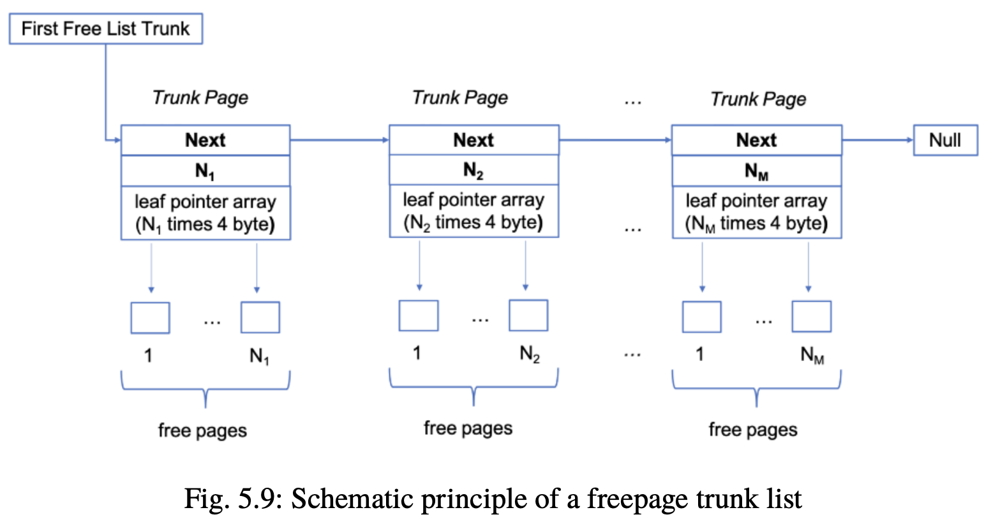

Slide 46
The freelist is a simple linked list consisting of trunk pages 5.9.
Each trunk page initially contains a 4-byte integer pointer referencing to the next trunk page in the list
A zero-byte value means that this is the last trunk page in the list, and the list ends here.
The second 4-byte value in a trunk page contains the number of leaf page offsets.

Slide 47
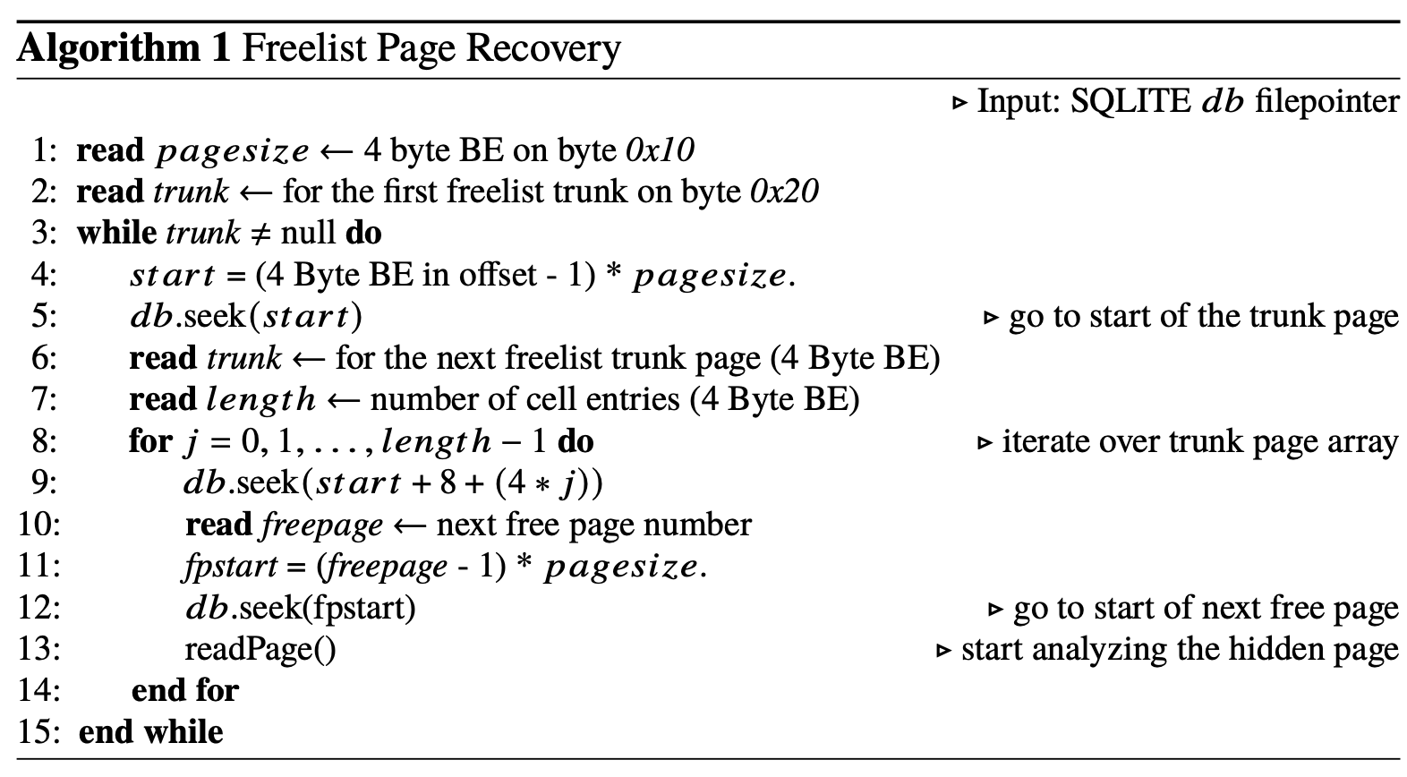

Slide 48
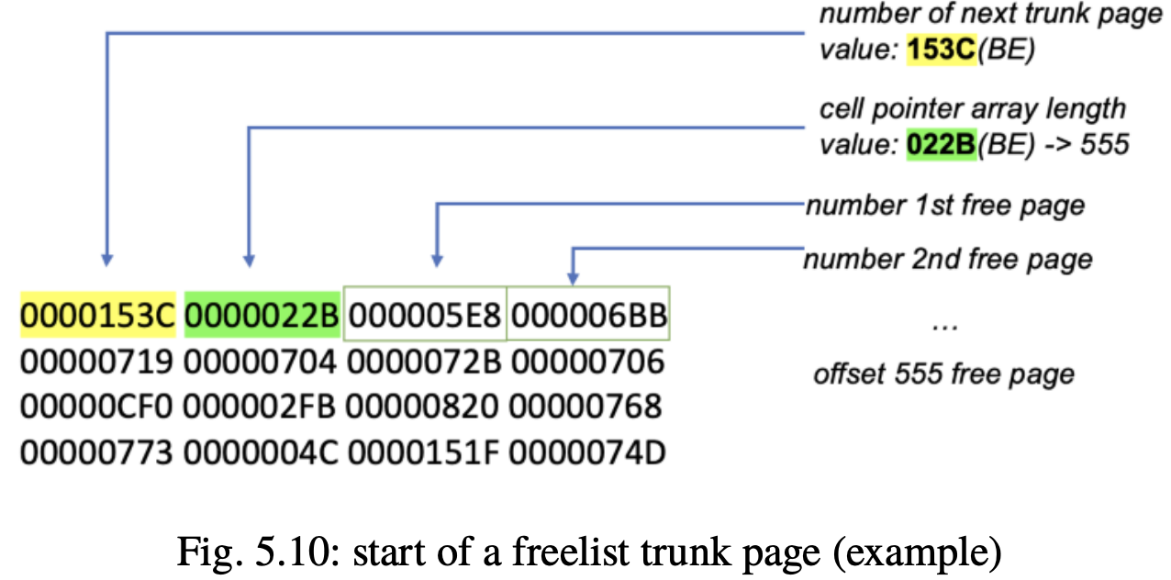

Slide 49
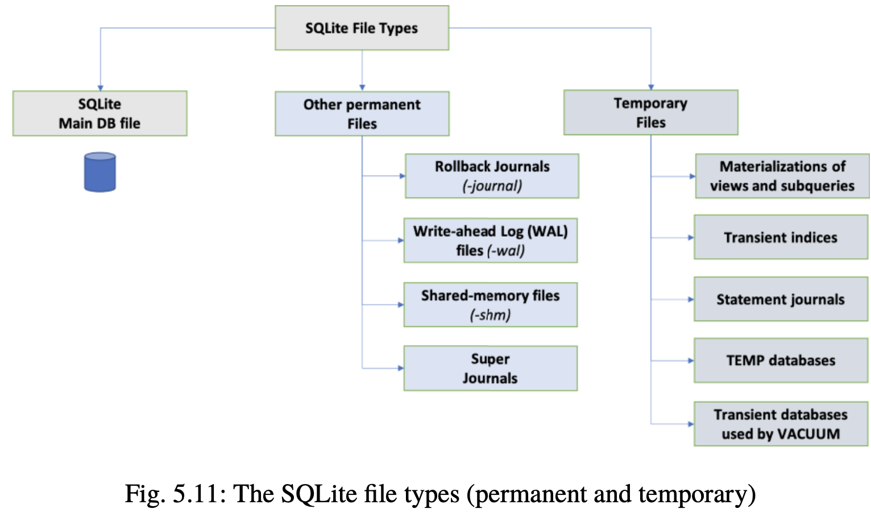

Slide 50
